Slide 1
Experimental Evidence on Adoption and Impact of the System of Rice Intensification
Christopher B. Barrett (Cornell), Asad Islam (Monash), Abdul Malek (Tsukuba), Deb Pakrashi (IIT Kanpur), and Ummul Ruthbah (Monash)
NEUDC 2020 @ Dartmouth
November 7, 2020

Slide 2
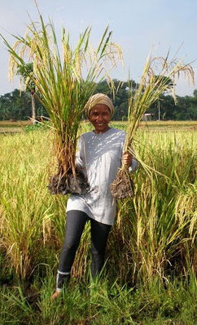
Specific Motivation: SRI Controversy
System of Rice Intensification(SRI) began in 1980s Madagascar.
Now diffused to >50 countries.
Just a change in agronomic practices. Uses no new purchased input. So often billed as ‘pro-poor’ and ‘sustainable’.
Photo credit: SRI-RICE
http://sri.ciifad.cornell.edu/

Slide 3
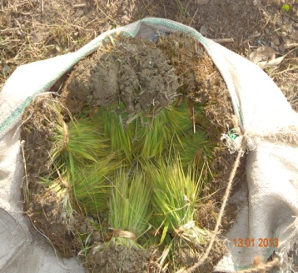
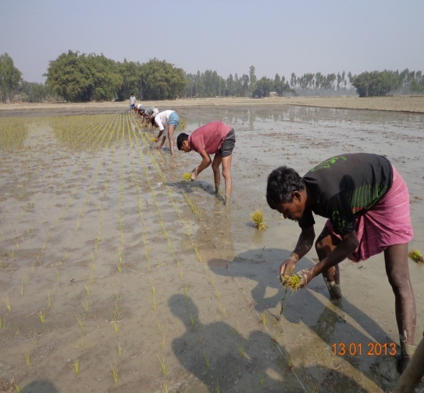
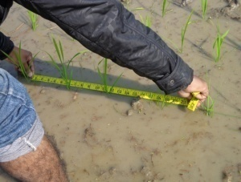
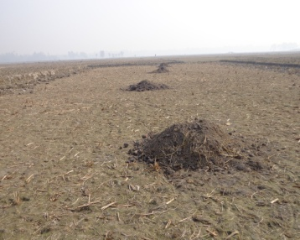
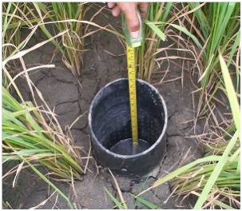
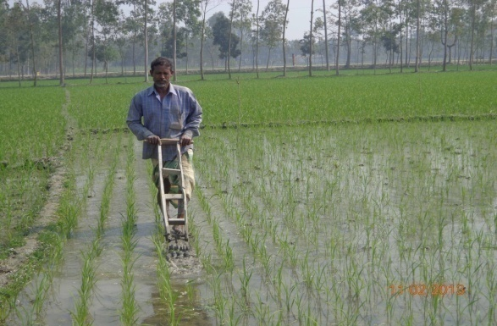
6 key SRI principles (BMPs) taught by BRAC (3 key differentiating, widely adopted practices in 1st row in bold)
Transplant seedlings @15-20 days (vs. 40-45 day)
1-2 seedlings per hill (vs. 4-5)
Wider spacing (25 × 20 cm) w/specific geometry (vs. no)
Use more organic fertilizer
Alternate wetting/drying (vs. continuously flooded)
Regular mechanical weeding (vs. chemicals)

Slide 4
What is the SRI Controversy?
Observational studies find big (30-80% yield/profit) gains.
Gains remain hotly disputed within rice science community (e.g., “Curiosity, Nonsense Non-science and SRI” or “Agronomic UFOs” both published in Field Crops Research).
Also, diffusion remains limited w/n countries and disadoption surprisingly high (often 15-40%). Casts doubts on gains.
To date, despite >1200 journal articles to date on SRI, no RCT to evaluate diffusion or farmer-managed gains.
Photo credit: SRI-RICE
http://sri.ciifad.cornell.edu/

Slide 5
Our contribution
BRAC fielded 1st large-scale, multi-year RCT on diffusion of and gains from SRI (in Bangladesh).
We find:
Modest (1 day) training on SRI induces significant uptake.
Uptake rises w/ level of direct/indirect SRI tng exposure.
Exposure to SRI training significantly increases rice yields and profits, household well-being indicators.
ITT estimates are invariant wrt to level of exposure.
No GE effects on rice prices or wage rates
High disadoption rates
Non-random selection into SRI adoption
Photo credit: SRI-RICE
http://sri.ciifad.cornell.edu/

Slide 6
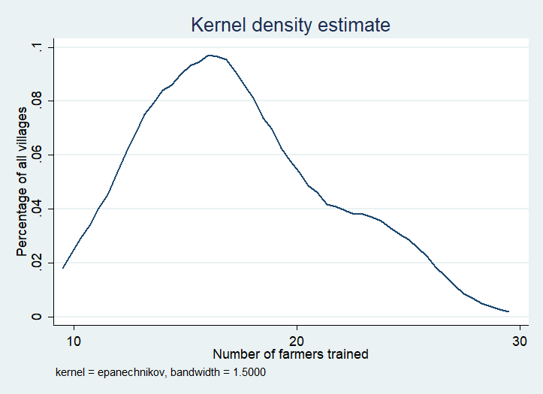
Experimental Design w/BRAC in rural Bangladesh
120 training villages (5 districts)
w/randomized saturation
62 control villages
1,856 farmers (C)
Randomized saturation
T1: 60 villages
Only one year of 1 day training
1,060 farmers trained (T1)
745 farmers untrained (U1)
T2: 60 villages
Two years of training
1,166 repeat trained (T2)
659 farmers untrained (U2)
30-40 farmers surveyed in each village. Random number (10-30) invited to training per village.
2,226 farmers trained, 1,404 untrained in training villages, 1,856 pure controls. Baseline (endline) sample = 5,486 (4,126)
No differential attrition across treatment arms.
Easily meets balance tests in all dimensions … well implemented.

Slide 7
Endline ITT ANCOVA estimates by treatment arm
SRI training has positive and significant adoption effects across the board
Strong spillover effects on untreated farmers in training villages
ITT effects on adoption increasing in intensity of exposure (C=0<U1<U2<T1<T2)
ITT effects on outcomes statistically indistinguishable among treatment arms
 | % SRI Adoption | Yield | Revenue | Total cost | Profit
One-time untreated (U1) | 9.5*** | 0.14*** | 0.17*** | 0.13*** | 0.21*
One-time treated (T1) | 38.7*** | 0.15*** | 0.17*** | 0.16*** | 0.22*
Two-time untreated (U2) | 12.4*** | 0.15*** | 0.17*** | 0.14*** | 0.29*
Two-time treated (T2) | 52.5*** | 0.17*** | 0.18*** | 0.16*** | 0.34***
Baseline outcome |  | 0.22*** | 0.21*** | 0.02 | 0.26***
Observations | 10,286 | 8,626 | 8,626 | 8,626 | 8,626
p-value (U1-T1) | 0.00 | 0.82 | 0.94 | 0.18 | 0.86
p-value (U1-U2) | 0.37 | 0.87 | 0.95 | 0.70 | 0.61
p-value (T1-T2) | 0.01 | 0.50 | 0.70 | 0.93 | 0.36
p-value (U2-T2) | 0.00 | 0.28 | 0.53 | 0.66 | 0.54
Results qualitatively identical using continuous treatment intensity, w/plot-level diff-in-diff, w/correction for multiple hypothesis testing, etc.

Slide 8
Nonlinear exposure intensity effects
ITT treatment intensity effect emerges > median (0.6) saturation. Effects concentrated among for T1 and U2 farmers.

Slide 9
LATE ANCOVA estimated effects of SRI adoption
Using the ITT estimate of SRI adoption as a first stage in the IV, we find:
SRI has big positive impacts on rice yields, costs and profits, consistent w/observational literature.
 | Ln(Rice Yield) | Ln(Rice Profit) | HH savings | HH food security | HH life satisfaction
Adopted SRI (IV=Treatment status) | 0.24*** | 0.47*** | 0.61*** | 0.58*** | 0.38**
Baseline outcome | 0.24*** | 0.29*** | 0.05*** | 0.03 | 0.07***
Control group mean | 3.06 | 5.69 | 84.38 | 4.59 | 7.38
1st stage F stats all >115. Results qualitatively same under continuous treatment and plot diff-in-diff.

Slide 10
Any GE effects?
One might naturally worry about general equilibrium impacts on labor and/or rice markets.
No wage rate effects. No sig rice price effects (and, if any, appear negative, reinforcing results).
(N=182 villages)
 | Endline wage rate | Endline rice price
Fraction sample trained | -17.08 | -1.09*
One-time training village | -0.38 | -0.14
Two-time training village | 0.26 | -0.02
Control village endline mean | 340.32 | 15.06
Adjusted R² | 0.323 | 0.250
10 SRI Bangladesh March 2020

Slide 11
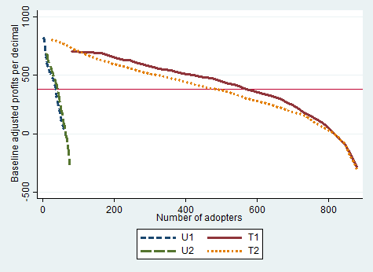
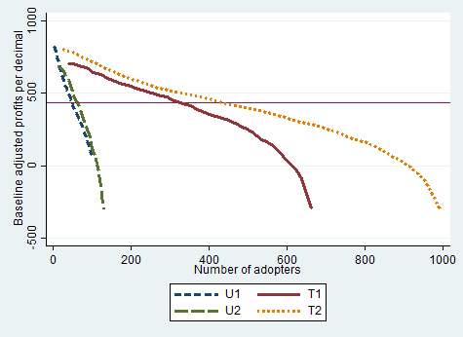
Insights from non-random selection into SRI uptake
If unobservables (e.g., skill) complement the technology and both positively affect productivity, then uptake will be non-random. If beliefs updating is a function of both intensity of exposure and expected outcome, then initial adoption will be by farmers who expect to benefit more.
Exposure intensity generates a clear scaling effect but negligible productivity effect.
Ordered profits by treatment status
Midline Endline

Slide 12
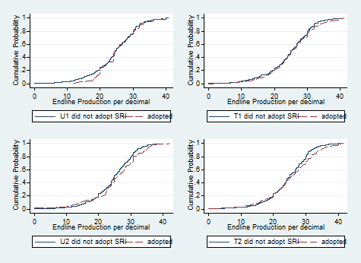
Insights from non-random selection into SRI uptake
No stochastic dominance at endline b/n adopters and non-adopters w/n treatment groups.
P-values decreasing w/
exposure intensity as
adherence to training
weakly improves w/
exposure intensity.
But farmers make reasonably
rational SRI uptake decisions
w/n each treatment group.

Slide 13
Disadoption and Delayed Adoption of SRI
Disadopters (36% of midline adopters):
Disadoption likelihood falls with training exposure intensity (22% for T2)
Relatively older and less educated, with more land.
Had highest midline cost of production.
Had smaller midline gain in profits (29%) vs. persistent adopters (53%).
Delayed Adopters (12% of midline non-adopters):
Delayed adoption likelihood increases with training exposure intensity
Lower midline production than persistent adopters.
Never Adopters (55% of sample in training villages):
Significantly lower baseline costs/higher profits, better off than adopters.
Possibly had little (least?) to gain from adoption of the SRI.
Persistent Adopters (21% of sample in training villages):
Had largest (smallest) midline-baseline Δprofits (Δ costs)

Slide 14
Conclusions
Higher intensity of SRI training exposure in both cross-section and time series has big diffusion effect, positive on uptake, negative on disadoption.
Exposure to SRI training significantly boosts rice yields and profits and hh well-being.
ITT/LATE of SRI adoption on rice yields (14-17/24%) or profits (21-34/47%) and household well-being outcomes are consistently positive and relatively large.
Highly non-random selection-on-unobservables into SRI adoption. Exposure mainly has a scaling effect.
Within treatment arm, adopters-nonadopters virtually indistinguishable by outcome. So selection-on-unobservables appears quite rational.
Also high rates of disadoption.
Thank you for your interest/comments!

